Slide 1
Customer Segmentation
Data Marvelss
Jithesh Kurungote Balakrishnan
Priti Sharma
Priyanka Math
Tharun Mukka

Slide 2
Customer Segmentation
Methodology using which we can divide our customer base into group of individuals, who are similar in terms of either gender, spending behavior, frequency to visit, age or other demographics
Notes:
The method through which you classify your consumers into groups based on shared qualities and spending habits.

Slide 3
It allows companies to precisely target the customers who has specific needs and desires
This way companies can design the targeted campaigns to the right group or audience

Slide 4
To Segment Customers calculate:
RFM Score for each customer
Create clusters using K-Means

Slide 5
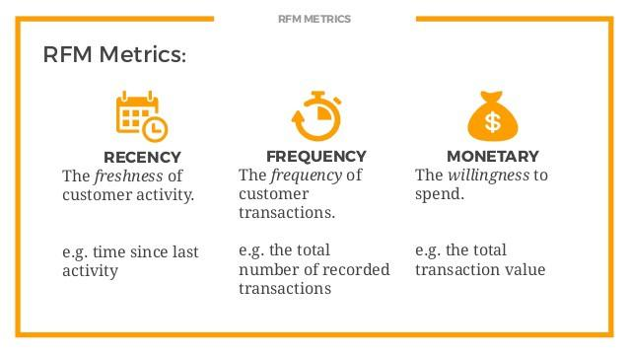

Slide 6

4 Clusters of Customers

Slide 7
Dataset
https://www.kaggle.com/carrie1/ecommerce-data
This is a transactional data set which contains all the transactions occurring between 01/12/2010 and 09/12/2011 for an online retail.
8 columns: Invoice number, Stock Code, Description, Quantity, Invoice Date, Unit Price, Customer ID & Country

Slide 8
Colab link: https://github.com/jithesh9539/Customer_Segmentation_Final/blob/main/Customer_Segmentation_CMPE255.ipynb
Github Link: https://github.com/jithesh9539/Customer_Segmentation_Final

Slide 9
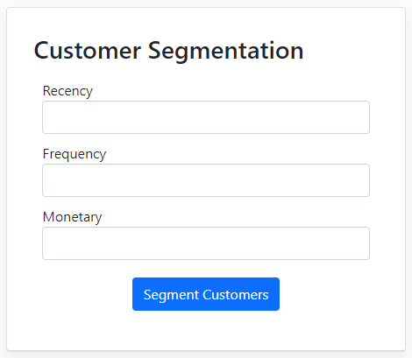
Application Demo
A Flask web app is created for the interaction between Client End and the trained Clustering model and deployed on Heroku
Deployed app link: https://customers-segmentation.herokuapp.com/

Slide 10
Thanks!

